Slide 1
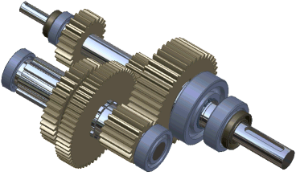
Kinematics of Machine (15ME42)
Course objectives
Students will
1. Familiarize with mechanisms and motion analysis of mechanisms.
2. Understand methods of mechanism motion analysis and their characteristics.
3. Analyse motion of planar mechanisms, gears, gear trains and cams.
Course outcomes
Students will be able to
1. Identify mechanisms with basic understanding of motion.
2. Comprehend motion analysis of planar mechanisms, gears, gear trains and cams.
3. Carry out motion analysis of planar mechanisms, gears, gear trains and cams.

Slide 2

MODULE 1
Introduction: Definitions: Link, kinematic pairs, kinematic chain, mechanism, structure, degrees of freedom, Classification links, Classifiction of pairs based on type of relative motion, Grubler's criterion, mobility of mechanism, Groshoff’s criteria, inversions of Grashoff’s chain.
Mechanisms: Quick return motion mechanisms-Drag link mechanism, Whitworth mechanism and Crank and slotted lever Mechanism. Oldham’s coupling, Straight line motion mechanisms Peaucellier's mechanism and Robert's mechanism. Intermittent Motion mechanisms: Geneva wheel mechanism, Ratchet and Pawl mechanism, toggle mechanism, pantograph, condition for correct steering, Ackerman steering gear mechanism.

Slide 3

INTRODUCTION

Slide 4

Theory of Machines
(Study of relative motion between the parts of a machine & the forces acting on those parts)
Kinematics of Machines
(Study of relative motion between the parts of a machine i.e. position, displacement, velocity & acceleration)
Dynamics of Machines
(Study of forces & their effects on the parts)
Kinetics
(Study of inertia forces which arises from the combined effect of the mass & motion of the machine parts)
Static
(Study of forces acting on various parts when those parts are assumed to be without mass or stationary)

Slide 5
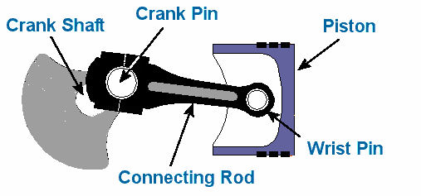
LINKS:
A link (or element or kinematic link) is a resistance body (or assembly of resistance bodies) that constitute the part (parts) of the machine connecting other parts which have motion relative to it.
Characteristics:
  It should have relative motion
  It need not necessarily be rigid body, but it must be a resistance body (a body capable of transmitting the required forces with negligible deformation).
Ex:
  Liquids which are resistance to compressive forces
  Chains, belts & ropes, which are resistance to tensile forces
A link which is stationary and which supports the moving members is called frame.

Slide 6
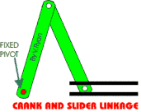
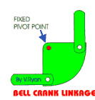
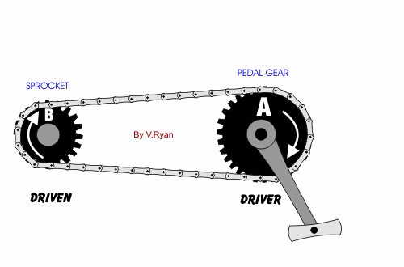
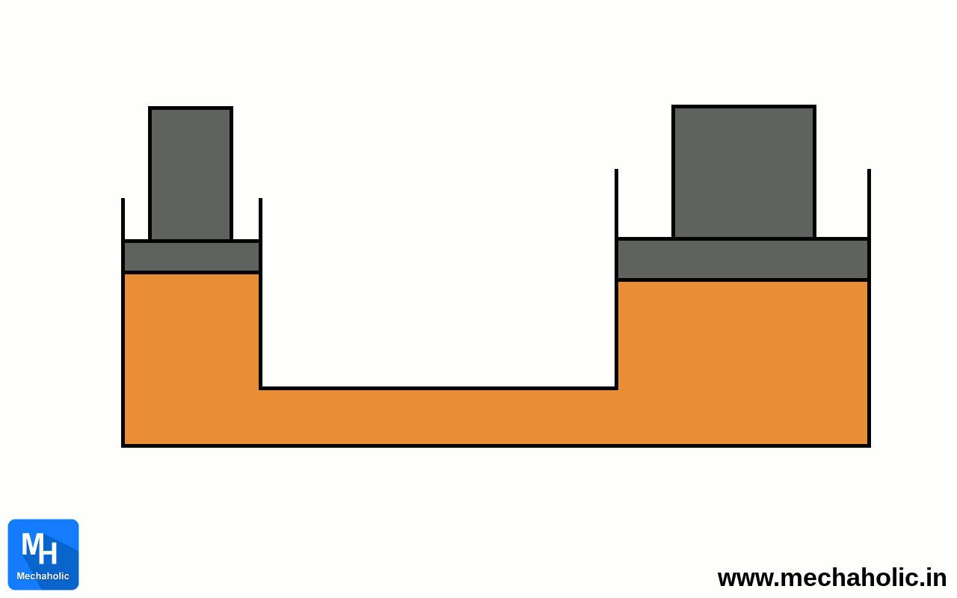
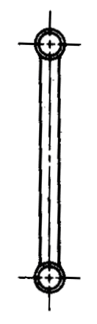
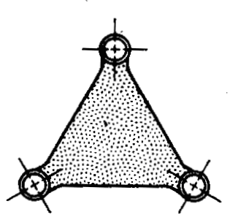
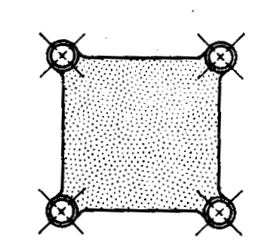
Link
Or
Element
Depending upon the ends on which revolute or turning pairs can be placed
Depending upon the effect on the link
Binary link
Rigid link
One which does not undergo any deformation while transmitting motion.
Ex: connecting rod, crank etc
Ternary link
Flexible link
One which partly deforms in a manner not to affect the transmission of motion.
Ex: belts, ropes, chains etc
Quaternary link etc
Fluid link
One which is formed by having a fluid in a receptacle & motion is transmitted through the fluid by pressure or compression only
Ex: hydraulic presses, jacks, brakes etc
Floating link
One which connected to the frame

Slide 7
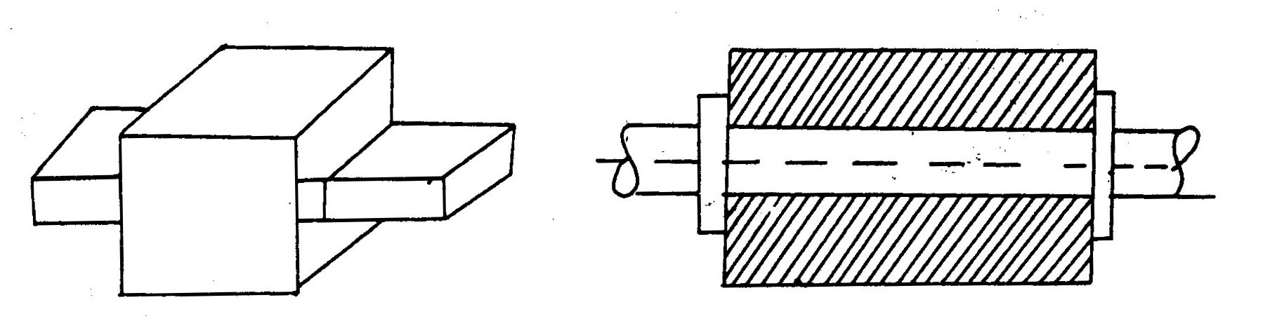
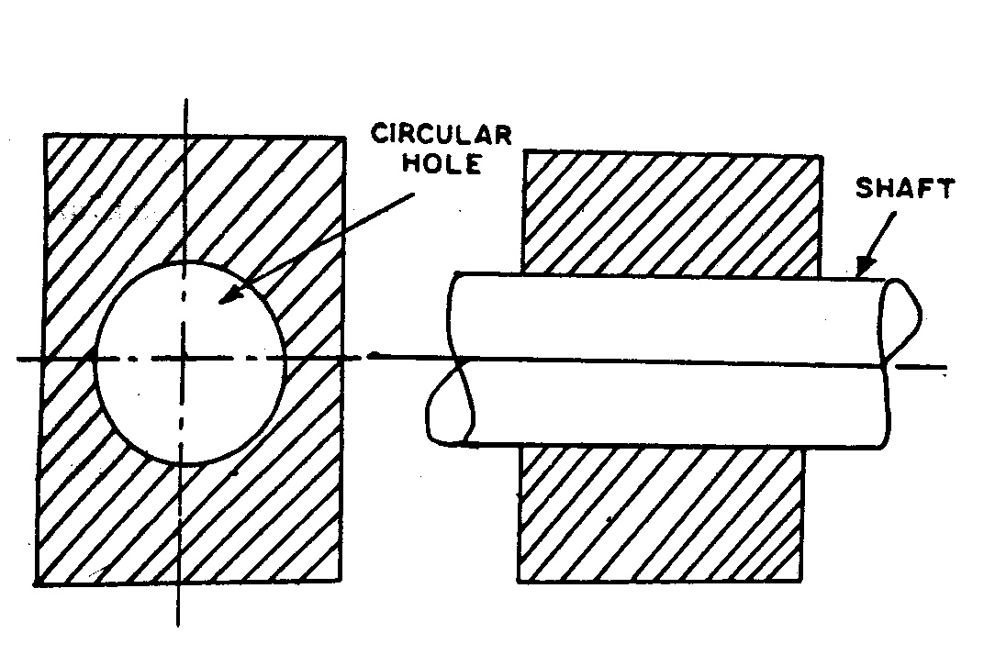
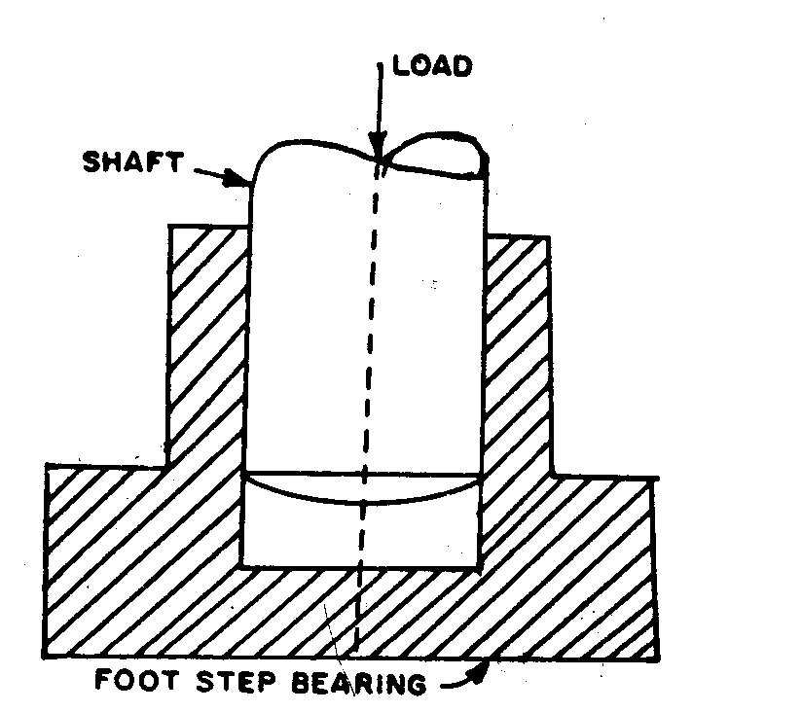
Kinematic pairs:
When two elements or links are connected together in such a way that their relative motion is completely constrained or successfully constrained, form a kinematic pair.
  Completely constrained: Motion between a pair of links is limited to a definite direction. Ex: motion of a shaft with collars at each end in a circular hole, motion of a square bar in a square hole, piston & cylinder
  Incompletely constrained: Motion between a pair of links is not confined to a definite direction. Ex: shaft in a circular hole
  Successfully constrained: Motion in a definite direction is not brought about by itself, but by some other means. Ex: shaft in foot step bearing

Slide 8
Kinematic pair’s classification
1. Based on type of contact between the elements
2. Based on relative motion between the elements
3. Based on mechanical constraints between the elements
Lower pair
Two elements of a pair have a surface contact when relative motion takes place
Self Closed pair
Two elements of a pair are connected together mechanically in such a way that only required kind of relative motion occurs.
Force closed (Open) pair
Two elements of a pair are not connected together mechanically but are kept in contact by the action of external forces.
Higher pair
Two elements of a pair have a point or line contact when relative motion takes place
Turning (revolute) pair
Two elements of a pair are connected in such a way that one can only turn or revolve about a fixed axis of another link.
Sliding pair
Two elements of a pair are connected in such a way that one can only slide relative to the other
Rolling pair
Two elements of a pair are connected in such a way that one rolls over another fixed link
Screw (helical) pair
Two elements of a pair are connected in such a way that one element can turn about the other by screw threads
Spherical pair
Two elements of a pair are connected in such a way that one element (with spherical shape) turns or swivels about the other fixed element

Slide 9
Lower pairs
Higher pairs
Link 2
(guide, slot)
Link 1
(slider)
1
2

Slide 10
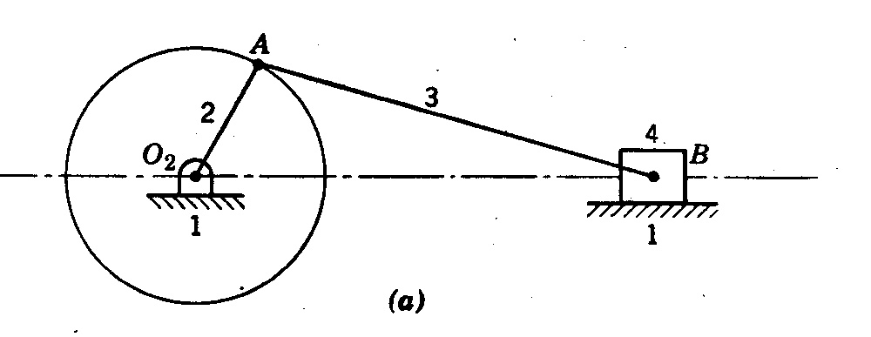

Kinematic chain
Combination of kinematic pairs, joined in such a way that each link forms a part of two pairs and the relative motion between the links (elements) is completely or successfully constrained.
They are coupled in such a way that the last link is always joined to the first link to transmit definite motion.
Example: Slider Crank Mechanism

Slide 11
If each link is assumed to form two pairs with two adjacent links, then the relation between the number of pairs (p) forming a kinematic chain and the number of links (l) may be expressed in the form of an equation:
        l = 2 p - 4 ………………………. (1)
Another relation between the number of links (l) and the number of joints (j) which constitute a kinematic chain is given by the expression:
        j = (3/2) l – 2 ………………………. (2)
Note:
  These two equations are applicable only to kinematic chains, in which lower pairs are used. These equations may also be applied to kinematic chains, in which higher pairs are used. In that case each higher pair may be taken as equivalent to two lower pairs with an additional element or link.
  If L.H.S > R.H.S. then the chain is locked
  If L.H.S = R.H.S. then the chain is constrained
  If L.H.S < R.H.S. then the chain is unconstrained

Slide 12
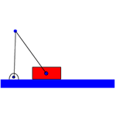
Mechanism
It is a constrained kinematic chain, with one link fixed, which is used to transmit or transform motion.

Slide 13
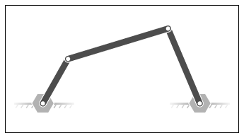
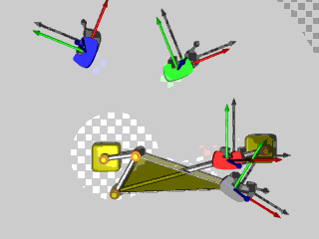
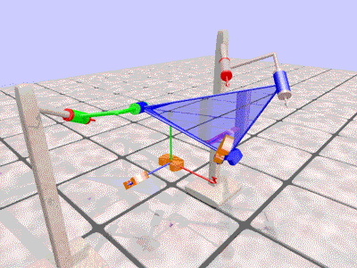
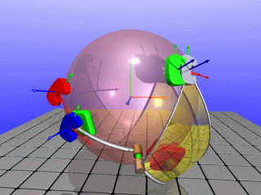
TYPES OF MECHANISM:
Simple mechanism: It has four links.
Compound mechanism: has more than four links.
Complex mechanism: formed by the inclusion of ternary or higher order floating link to a simple mechanism.
Planar mechanism: formed when all links of the mechanism lie in the same plane.
Spatial mechanism: formed when all links of the mechanism lie in the different plane.
Equivalent mechanism: formed when one pairs is replaced by other type of pairs and the new mechanism obtained must have the same number of degrees of freedom as the original mechanism.
  Example:
  A turning pair can be replaced by a sliding pair
  A spring can be replaced by two binary links
  A cam pair can be replaced by one binary link with two turning pairs at each end.

Slide 14
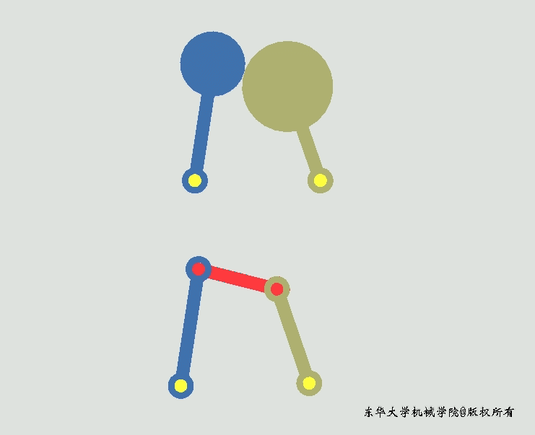
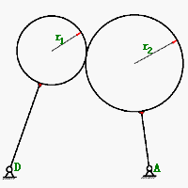
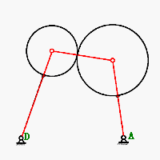
7.Replace higher pairs with lower pairs
Example 1:
Both of the link are circles

Slide 15
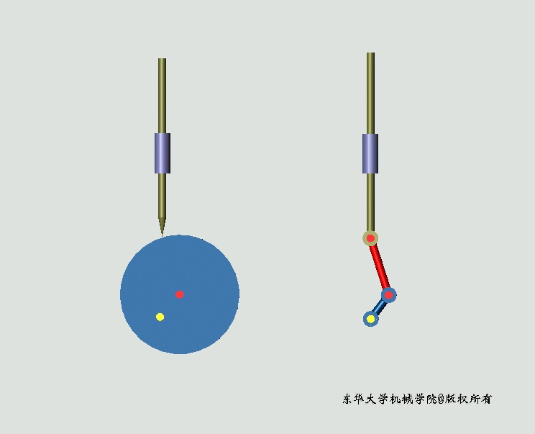
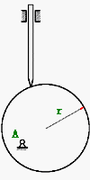
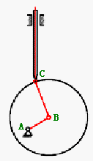
7.Replace higher pairs with lower pairs
Example 2
One is a circle, the other is a point.

Slide 16
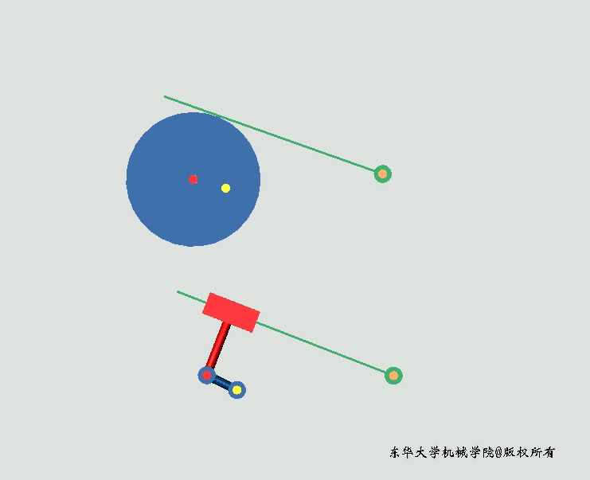
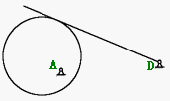
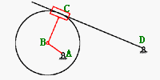
7.Replace higher pairs with lower pairs
Example 3:
One is a line, the other is a circle.

Slide 17
Machine:
A machine is a mechanism or group of mechanisms used to perform useful work.
Its chief function is to adopt a source of power to some specific work requirements.
Kinematic pairs
When connected as per Eq. 1 & 2
Kinematic chain
When one link is fixed
Mechanism
When forces and motions are transmitted
Machine

Slide 18
Structure
It is an assemblage of a number of resistance bodies having no relative motion between them.
These are meant for taking up loads.
There is only straining action due to forces acting on them.

Slide 19
Difference between machine and structure
SI. No. | Particulars | Machine | Structure
1 | Definition | A machine is a mechanism or group of mechanisms used to perform useful work | It is an assemblage of a number of resistance bodies having no relative motion between them
2 | Work | Modifies or transmit energy to do some kind of work | Modifies & transmit force only
3 | Relative motion | Exists between its members | Not exists between its members
4 | Energy | Transmits useful energy | No energy transmission
5 | Examples | Steam engine, shaper etc | Roof truss, railway bridges, machine frames etc

Slide 20
Difference between machine & mechanism
SI. No. | Particulars | Mechanism | Machine
1 | Definition | It is a constrained kinematic chain, with one link fixed, which is used to transmit or transform motion | A machine is a mechanism or group of mechanisms used to perform useful work
2 | Purpose | To transmit or transform motion | To transmit energy or to do useful work
3 | Dependency | No mechanism is necessarily a machine | A machine is a series or train of mechanism
4 | Relationship | It is a working model of any machine | It is a practical development of any mechanism
5 | Examples | Clock, mini-drafter etc | Steam engine, shaper etc

Slide 21
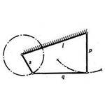
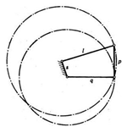
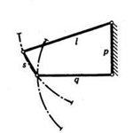
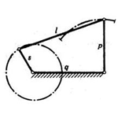
Inversion:
The exchange of fixedness of an element with its mating element in a kinematic chain is called inversion.
In the fig. any one of the links may be arbitrary selected as the fixed link, and each arrangement is an inversion of the others.
Note: Relative motions between the various links is not changed in any manner through the process of inversion, but their absolute motions may be changed drastically

Slide 22
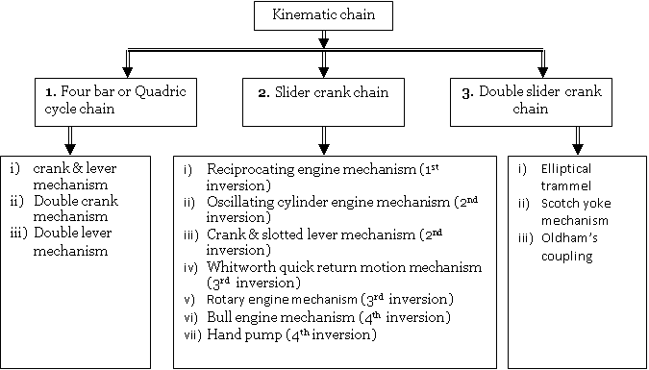
KINEMATIC CHAINS AND INVERSIONS

Slide 23
GRASHOF’S LAW
For a four bar mechanism, the sum of the shortest & the longest link lengths should not be greater than the sum of the remaining two link lengths if there is to be continuous relative motion between the two links
s + l < p + q
where:
s = shortest link length,
l = longest,
p & q = intermediate length links

Slide 24
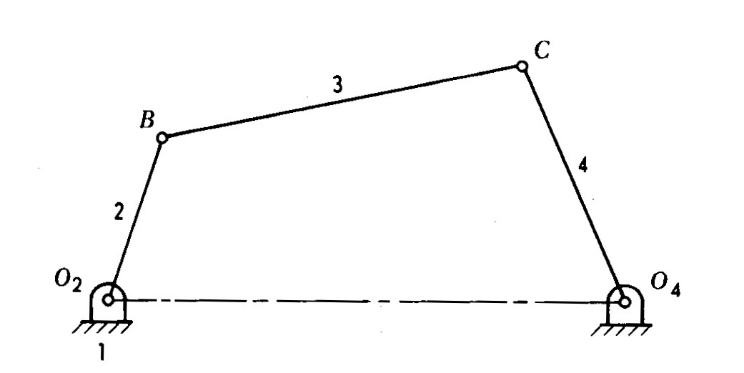
Four bar or Quadric cycle chain
(link 1) frame
(link 2) crank
(link 3) coupler
(link 4) rocker

Slide 25
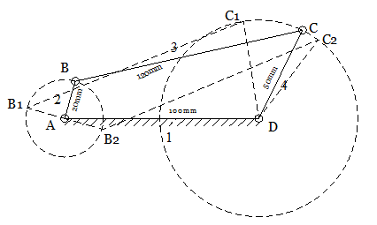
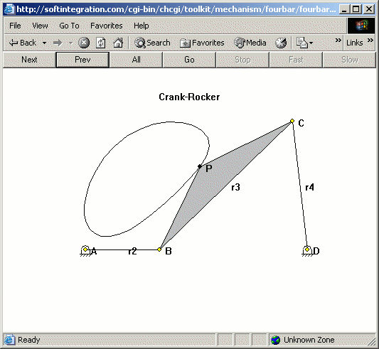
I & II inversions
Crank & lever mechanism (rotary & oscillatory motion)

Slide 26
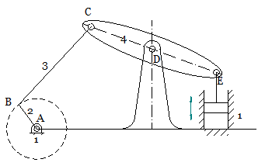
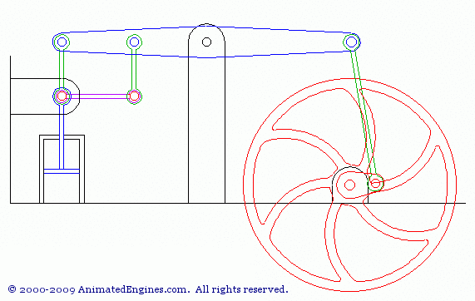
Beam engine:

Slide 27
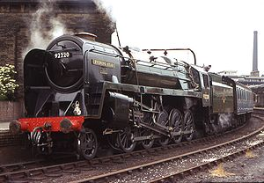
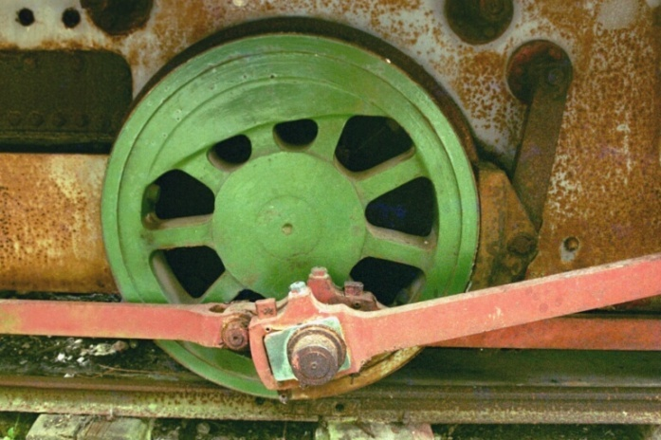
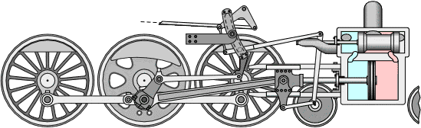
III inversions
Double crank mechanism (complete rotation of the crank & follower)
1. Coupling rod of locomotive

Slide 28
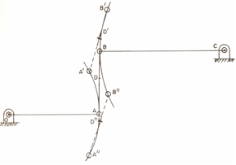
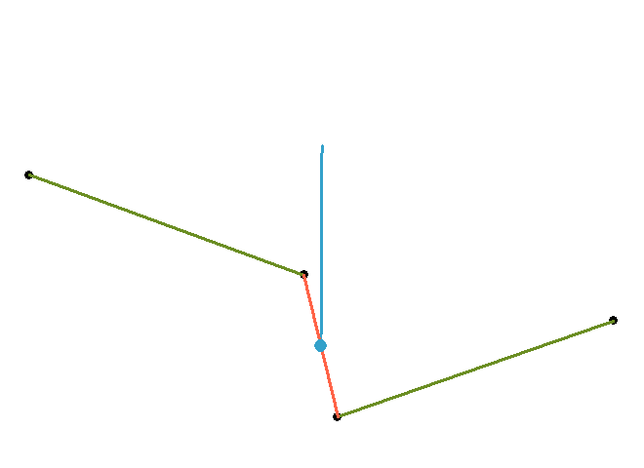
IV inversions
Double lever mechanism (oscillatory motion)
1. Watt’s straight line mechanism
WORKING

Slide 29
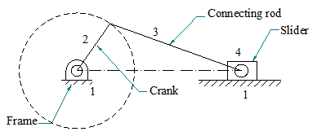
2. Slider crank chain

Slide 30
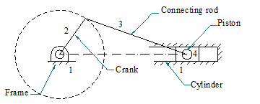
Reciprocating engine mechanism (1st inversion)
When link 1 is fixed, link 2 is made as crank and link 4 is made as slider, then first inversion of single slider crank is obtained
Example: steam engine, compressors, pumps, I.C. engines etc

Slide 31
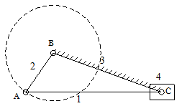
Second inversion:
The second inversion is obtained by fixing the link 3 (connecting rod).
Link 2 acts as a crank and is rotating about the point B.
Link 4 oscillates.

Slide 32
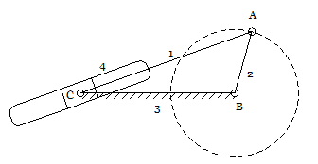
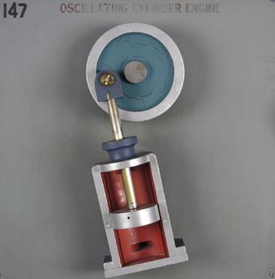
Oscillating cylinder engine mechanism (2nd inversion)
WORKING
It is used to convert reciprocating motion into rotary motion.
In this mechanism, the link 3 forming the turning pair is fixed which corresponds to connecting rod of a reciprocating steam engine mechanism.
When the crank (link 2) rotates, the piston attached to the piston rod (link 1) reciprocates and the cylinder (link 4) oscillates about a pin pivoted to the fixed link at C.

Slide 33
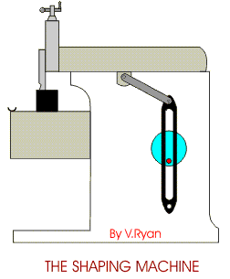
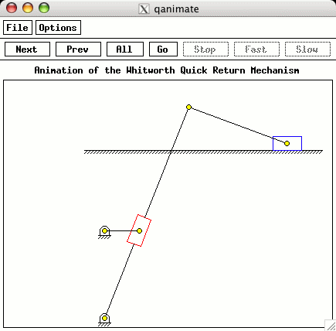
Crank & slotted lever mechanism (2nd inversion)
α>β

Slide 34
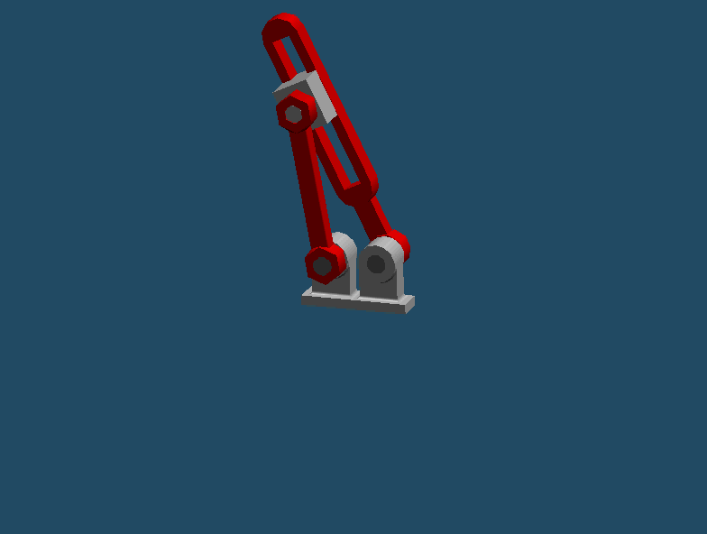

Third inversion
  By fixing the link 2 (crank) third inversion is obtained.
  Link 3 along with slider at its end C, becomes a crank.
  Hence link 3 along with slider (link 4) rotates about B.
  By doing so, the link 1 rotates about A along with the slider (link 4) which reciprocates on link 1.

Slide 35
Whitworth quick return motion mechanism (3rd inversion)
α>β
WORKING

Slide 36


Rotary engine or Gnome engine mechanism (3rd inversion)
WORKING
It is a rotary cylinder V type internal combustion engine used as an aero-engine, which now has been replaced by gas turbine.

Slide 37

Fourth inversion
  By fixing the link 4 (sliding pair or cylinder) fourth inversion is obtained.
  Link 3 can oscillate about the fixed point C on link 4.
  This makes end B of link 2 to oscillate about C and end A reciprocates along the axis of the fixed link 4.

Slide 38



Bull engine mechanism (4th inversion)
Hand pump (4th inversion)

Slide 39
3. Double slider crank chain
It is a four-bar kinematic chain containing two turning pairs and two sliding pairs.
Link 1 & link 2 is sliding pair, link 2 & link 3 is turning pair, link 3 & link 4 is second turning pair, link 4 & link 1 is second sliding pair.
Also the two pairs of the same kind are adjacent (To adjacent pairs 23 & 34 are turning pairs where as the other two pairs 12 & 14 are sliding pairs)

Slide 40
First Inversion
When link 1 is fixed, the first inversion is obtained as shown in the fig.
Two adjacent pairs 23 and 34 are turning pairs where as the other two pairs 12 and 14 are sliding pair.
WORKING

Slide 41


Elliptical trammel
This is the equation of ellipse. Hence the path traced by the point C is an ellipse whose semi major axis is AC and semi minor axis is BC

Slide 42
Second inversion
When link 2 or link 4 of the double slider crank chain is fixed, the second inversion is obtained.
Here link 2 is fixed and end B of the link 3 rotates about the about A and link 4 will reciprocate in the vertical slot.
Hence, link 1 reciprocates in the horizontal direction.

Slide 43


Scotch yoke mechanism
WORKING

Slide 44
Third inversion:
When the link 3, of the double slider crank chain is fixed & link 1 is free to move, the third inversion is obtained.
In this case each of the slider blocks (i.e. link 2 & link 4) can turn about the pins A & B. if one slide block (say link 2) is turned through an definite angle, the frame (i.e. link 1) and other block (i.e. link 4) must turn through the same angle.

Slide 45




Oldhaum’s coupling
Application: Used for connecting two parallel shafts when the distance between the two shafts is small.

Slide 46
Degrees of freedom OR Mobility of Mechanism
It is defined as the number of independent relative motions, both translational & rotational, a pair can have.
An unconstrained rigid body moving in space can describe the following independent motions.
  Translation motion along three mutually perpendicular axes x, y & z
  Rotation motion about these axes.
Thus a rigid body possesses 6 degrees of freedom.
The connection of a link with another imposes certain constraints on their relative motion.
The number of restraints can never be zero (joint is disconnected) or six (joint becomes solid).
Degrees of freedom = 6 – number of restraints

Slide 47
GRUBLER’S CRITERION
The Grubler’s mobility equation for a planar mechanism is
F = 3 (l - 1) - 2j₁ – j₂
Where,
F = mobility of number of degrees of freedom
l = number of links including frame
j₁ = joints with single (one) degree of freedom (lower pairs or binary joints)
j₂ = joints with two degrees of freedom (higher pairs)
F > 0, results a mechanism with F degrees of freedom
F = 0, results in a statically determinate structure
F < 0, results in a statically indeterminate structure
A joint connecting l links at a single point must be counted as (l-1) joints.

Slide 48
Examples: (mechanisms with lower pairs)
F = 3 (l - 1) - 2j₁ – j₂
l=3
j1=3
j2=0
F = 3 (3 - 1) - 2 × 3 – 0
F=0
Therefore statically determinate structure
F = 3 (l - 1) - 2j₁ – j₂
l=5
j1=5
j2=0
F = 3 (5 - 1) - 2 × 5 – 0
F=2
Therefore mechanism with 2 degrees of freedom
F = 3 (l - 1) - 2j₁ – j₂
l=6
j1=8
j2=0
F = 3 (6 - 1) - 2 × 8 – 0
F=-1
Therefore statically indeterminate structure

Slide 49

F = 3 (l - 1) - 2j₁ – j₂
l=4
j1=4
j2=0
F = 3 (4 - 1) - 2 × 4 – 0
F=1
Therefore mechanism with 1 degrees of freedom I.e., one input to any one link will result in definite motion of all the links.
F = 3 (l - 1) - 2j₁ – j₂
l=5
j1=5
j2=0
F = 3 (5 - 1) - 2 × 5 – 0
F=2
Therefore mechanism with 2 degrees of freedom I.e., two inputs to any two links are required to yield definite motions in all the links.

Slide 50


F = 3 (l - 1) - 2j₁ – j₂
l=6
j1=7
j2=0
F = 3 (6 - 1) - 2 × 7 – 0
F=1
Therefore mechanism with 1 degrees of freedom I.e., one input to any one link will result in definite motion of all the links.
F = 3 (l - 1) - 2j₁ – j₂
l=6
j1=7
j2=0
F = 3 (6 - 1) - 2 × 7 – 0
F=1
Therefore mechanism with 1 degrees of freedom I.e., one input to any one link will result in definite motion of all the links.

Slide 51

F = 3 (l - 1) - 2j₁ – j₂
l=11
j1=15
j2=0
F = 3 (11 - 1) - 2 × 15– 0
F=0
Therefore statically determinate structure

Slide 52
Example : (mechanisms with higher pairs)
F = 3 (l - 1) - 2j₁ – j₂
l=3
j1=2
j2=1 (there exist a rolling & sliding between 2 & 3)
F = 3 (3 - 1) - 2 × 2 – 1
F=1
Therefore mechanism is of 1 degree freedom system
F = 3 (l - 1) - 2j₁ – j₂
l=4
j1=3
j2=1 (there exist a rolling & sliding between 4 & 1)
F = 3 (4 - 1) - 2 × 3 – 1
F= 2
Therefore mechanism is of 2 degree freedom system

Slide 53

F = 3 (l - 1) - 2j₁ – j₂
l=3
j1=2
j2=1 (there exist a rolling & sliding between 2 & 3)
F = 3 (3 - 1) - 2 × 2 – 1
F=1
Therefore mechanism is of 1 degree freedom system
F = 3 (l - 1) - 2j₁ – j₂
l=3
j1=2
j2=1 (there exist a rolling & sliding between 2 & 3)
F = 3 (3 - 1) - 2 × 2 – 1
F=1
Therefore mechanism is of 1 degree freedom system

Slide 54

MECHANISMS

Slide 55
Quick – Return mechanisms
Repetitive operations.
Mechanism is under load, called working stroke.
Return stroke.
Time ratio.
To produce quick return, the time ratio must be greater than unity and as large as possible.
Quick return mechanisms are used on machine tools to give a slow cutting stroke and a quick return stroke for a constant angular velocity of the driving crank.
The most commonly used types of quick return mechanisms are
  Drag link mechanism
  Whitworth mechanism
  Crank & Slotted lever Mechanism

Slide 56
Drag link quick return mechanism (complete rotation of the crank & follower)
WORKING

Slide 57
Straight line motion mechanisms
Straight line motion mechanisms
Used to produce straight motions.
Mechanisms may produce exactly straight line motion or approximate straight line motion.
Either only turning pairs are connected or one sliding pair is used.
Exact straight line motion mechanisms
Approximate Straight line motion mechanisms
Having only turning pairs
Having one sliding pair
Watt’s straight line mechanism
Peaucellier mechanism
Scott-Russel mechanism
Roberts’s mechanism
Hart’s mechanism
Modified Scott-Russel mechanism
Tchebicheff’s mechanism
Grass-Hooper mechanism

Slide 58

Condition for exact straight line motion mechanisms using only turning pairs
Principle:
Let O be the centre of a circle of diameter AD.
AB is any chord.
The triangle inscribed on a semi circle (i.e. ΔABD) will be right angled triangle.
The chord produced up to the point C.
From C, draw a line CE perpendicular to the diameter AD produced.
Then locus of point C will be straight line, perpendicular to the diameter AD, provided the product of AB × AC is a constant.
Proof:
The Δs AEC & ABD are similar as ∠DAB = ∠EAC (common angle) and ∠ABD = ∠EAC = 90°
Hence,
Or
AB × AC = AD × AE
But AD is the diameter of the circle and hence it is constant.
If AE also constant then AB × AC will be a constant when the perpendicular from the point C always coincides with point E.
Hence the projection of C should always be at E.

Slide 59


PEAUCELLIER MECHANISM
WORKING
It consist of eight links i.e. links AO, OE, AB, AD, EB, BC, CD and DE in which link AO is fixed and the link OE is rotating about point O, as shown in the fig.
Links BC = CD = DE = EB, thus form a rhombus and link AB = AD.
All the links are connected to pin joints.
The pin at E is constrained to move along the circumference of a circle of diameter AF by means of link OE, thus OA = OE.
As the link OE moves around O, the point C moves in the straight line perpendicular to AO produced.

Slide 60
Since BCDE is a rhombus, the diagonals EC & BD will bisect each other at right angles. Hence ∠ELB = ∠CLB = 90° .
Also the ∠AEF will be right angle for all positions of E, as it is angle subtended by a diameter of the circle on the circumference of the circle.
In ΔAEB & ΔADE, AB = AD, BE = ED & AE is common. Therefore these two triangles are similar.
Hence ∠EAB = ∠EAD. Therefore point E lies on the bisector of ∠DAB……………………...(1)
In ΔACB & ΔACD, AB = AD, BC = CD & AC is common. Therefore these two triangles are similar.
Hence ∠CAB = ∠CAD. Therefore point C lies on the bisector of ∠DAB………………………(2)
From (1) & (2), it is clear that AEC is a straight line.
Now in right angled triangle ALB,
……………….. (3)
Now in right angled triangle CLB,
…………………….. (4)
Subtracting equation (4) from (3), we get
But AB & BC are of constant lengths; therefore the product AE×AC remains constant.
Hence point C traces a straight path perpendicular to the diameter AF produced.
Hence point C moves in a straight line perpendicular to AO produced.

Slide 61


Robert’s Straight Line Mechanism

Slide 62


INTERMITTENT MOTION MECHANISM
Geneva mechanism
D- Driving Wheel
P- Pin
F- Follower
WORKING
Used in preventing overriding of main springs in clocks and watches, feeding of film n projectors and indexing working table on machine tool

Slide 63


RATCHET & PAWL MECHANISM
2-Ratchet wheel
3- Pawl
4- Lever
5- Pawl
Used in Feed mechanisms, lifting jacks, clocks, watches & counting devices

Slide 64
Toggle Mechanism
WORKING
Used in toggle clamps, riveting machines, punch presses, stone crushers, etc.

Slide 65


PANTOGRAPH
WORKING

Slide 66
Uses of Pantograph
Pantograph is used as geometrical instrument
Pantograph is used to guide the cutting tools
Used as an indicator rig to reproduce the displacement of cross head of reciprocating engine

Slide 67


Condition for correct steering in motor cars
AC = EF = EG – FG……(1)
In Δ CFG, tanθ = CF/FG
FG = CF/ tanθ = CF cotθ….(2)
In Δ AEG, tanφ = AE/EG
EG = AE/ tanϕ = AEcotφ….(3)
Substituting (2) & (3) in (1), we get
AC = AE cotφ - CF cotθ
= AE (cotφ - cotθ)
cotϕ - cotθ = AC/AE = a/w
cotφ - cotθ = AC/AE = a/w
Condition for correct steering
Notes:
The condition of the good steering is that, the relative motion between the wheels of the vehicle and the road surface must be one of pure rolling.

Slide 68
Ackermann steering gear mechanism
Notes:
consists only of turning pairs and is based on a four bar chain
only turning pairs wear & tear of the parts is less & cheaper
AB & KL are parallel and the links AK & BL each inclined at an angle α
steers about the right as shown in the fig., the short link BL turned so as to increase the α, whereas the long link LK causes the other short link AK to turn so as to reduce α.
AK turns is less than the angle θ through which the BL turns
Three correct steering position will be:
when moving straight
When moving one correct angle to the right corresponds to the link ratio AK/AB and angle α.
Similar position when moving to the left.

Slide 69


